Slide 1


Harman Singh
10 September 2026

Slide 2

Outline
• Executive Summary
• Introduction & business problem
• Methodology: API, scraping, wrangling, EDA, SQL, Folium, Dash, classification
• Results: visual EDA, SQL, interactive analytics and model performance
• Conclusions, innovative insights and appendix
SpaceX Falcon 9 Capstone

Slide 3
Executive Summary
Falcon 9 records
Overall landing success
Top launch volume
Best test accuracy
90
66.7%
55
83.33%
Analyzed launch records
90 launches; Class = 1
CCAFS SLC 40
LR / SVM / KNN tie
• Combined SpaceX REST API data with Wikipedia launch records, then cleaned and transformed the data for analysis.
• EDA and SQL revealed strong time, site, orbit and payload patterns in first-stage landing outcomes.
• Interactive Folium and Plotly Dash views translated the findings into geographic and operational decision support.
• Four classifiers were evaluated; the standard capstone test split produced 83.33% accuracy for Logistic Regression, SVM, Decision Tree and KNN.
SpaceX Falcon 9 Capstone

Slide 4
Introduction
Project background & context
Questions addressed
• SpaceX reduced launch costs through Falcon 9 first-stage reusability.
• The project treats launch history as a data science problem: understand the drivers of landing success and predict future outcomes.
• Target outcome: a reusable, evidence-based framework for evaluating first-stage landing risk before launch.
• Which launch sites and orbits are associated with higher landing success?
• How do payload mass and flight number relate to landing outcome?
• Can a classification model predict whether the first stage will land successfully?
SpaceX Falcon 9 Capstone

Slide 5

Section 1

Slide 6
Methodology
1
2
3
4
5
Collect
Wrangle
Explore
Interact
Predict
SpaceX REST API + Wikipedia scraping
Normalize JSON, merge datasets, clean nulls
Python visualization + SQL aggregation
Folium maps + Plotly Dash
Feature engineering + 4 classifiers + GridSearchCV
End-to-end workflow: raw launch records → analysis-ready landing labels → descriptive insights → interactive decision tools → predictive classification.
SpaceX Falcon 9 Capstone

Slide 7
Data Collection
SpaceX API
Wikipedia
Join
Output
GET launch records; normalize JSON with pandas.json_normalize
→
Scrape Falcon 9 launch table for mission and booster attributes
→
Align launch dates / flight numbers and combine fields
→
Analysis-ready Falcon 9 launch dataset
Data collection emphasized reproducibility: source → extraction → normalization → merge → validation.
SpaceX Falcon 9 Capstone

Slide 8
Data Collection – SpaceX API
GET
JSON
Normalize
Extract
Merge
SpaceX REST endpoint
→
Raw response
→
pd.json_normalize
→
rocket / payload / launchpad / core
→
Analysis table
• Static-fire and launch timestamps were retained for temporal analysis.
• Falcon 1 records were removed so the modeling target represented Falcon 9 first-stage landings.
• Landing-pad, payload and launch-site fields were preserved for downstream EDA.
Notebook reference
GitHub URL: YOUR_REPOSITORY_URL
SpaceX Falcon 9 Capstone

Slide 9
Data Collection – Scraping
Data Collection - Scraping
Wikipedia
Parse
Clean
Merge
Falcon 9 / Falcon Heavy launch table
→
HTML tables → pandas
→
Dates, booster versions, outcomes
→
Join with API-derived records
Web scraping supplied mission-level fields that complement the API, especially launch / booster / outcome information used to define the supervised learning label.
GitHub URL: YOUR_REPOSITORY_URL
SpaceX Falcon 9 Capstone

Slide 10
Data Wrangling
Filter
Clean
Transform
Encode
Split
Keep Falcon 9 launches
→
Handle missing landing-pad values
→
Convert outcomes to binary Class
→
One-hot categorical features
→
Train / test for modeling
Target label: Class = 1 for successful first-stage landing; Class = 0 for unsuccessful / no landing. Numeric fields were retained for payload and flight-history effects.
GitHub URL: YOUR_REPOSITORY_URL
SpaceX Falcon 9 Capstone

Slide 11
EDA with Data Visualization
• Scatter plots: Flight Number vs. Launch Site; Payload vs. Launch Site; Flight Number vs. Orbit; Payload vs. Orbit.
• Bar chart: success rate by orbit type.
• Line chart: yearly average landing success.
• Color / marker encoding separates successful and unsuccessful landings.
• Why these charts? They expose temporal trends, geographic differences, mission-profile effects and potential non-linear relationships.
• Visual EDA guided feature selection and the predictive modeling stage.
• Notebook reference: YOUR_REPOSITORY_URL
SpaceX Falcon 9 Capstone

Slide 12
EDA with SQL
• SELECT DISTINCT → enumerate unique launch sites.
• LIKE 'CCA%' + LIMIT → inspect CCAFS launch records.
• SUM / AVG → quantify payload capacity and average F9 v1.1 payload.
• MIN → locate the first successful ground-pad landing.
• WHERE + payload range → identify successful drone-ship landings between 4,000–6,000 kg.
• GROUP BY / COUNT → summarize mission outcomes and landing outcomes over time.
• Subquery + MAX → identify boosters carrying the maximum payload.
GitHub URL: YOUR_REPOSITORY_URL
SpaceX Falcon 9 Capstone

Slide 13
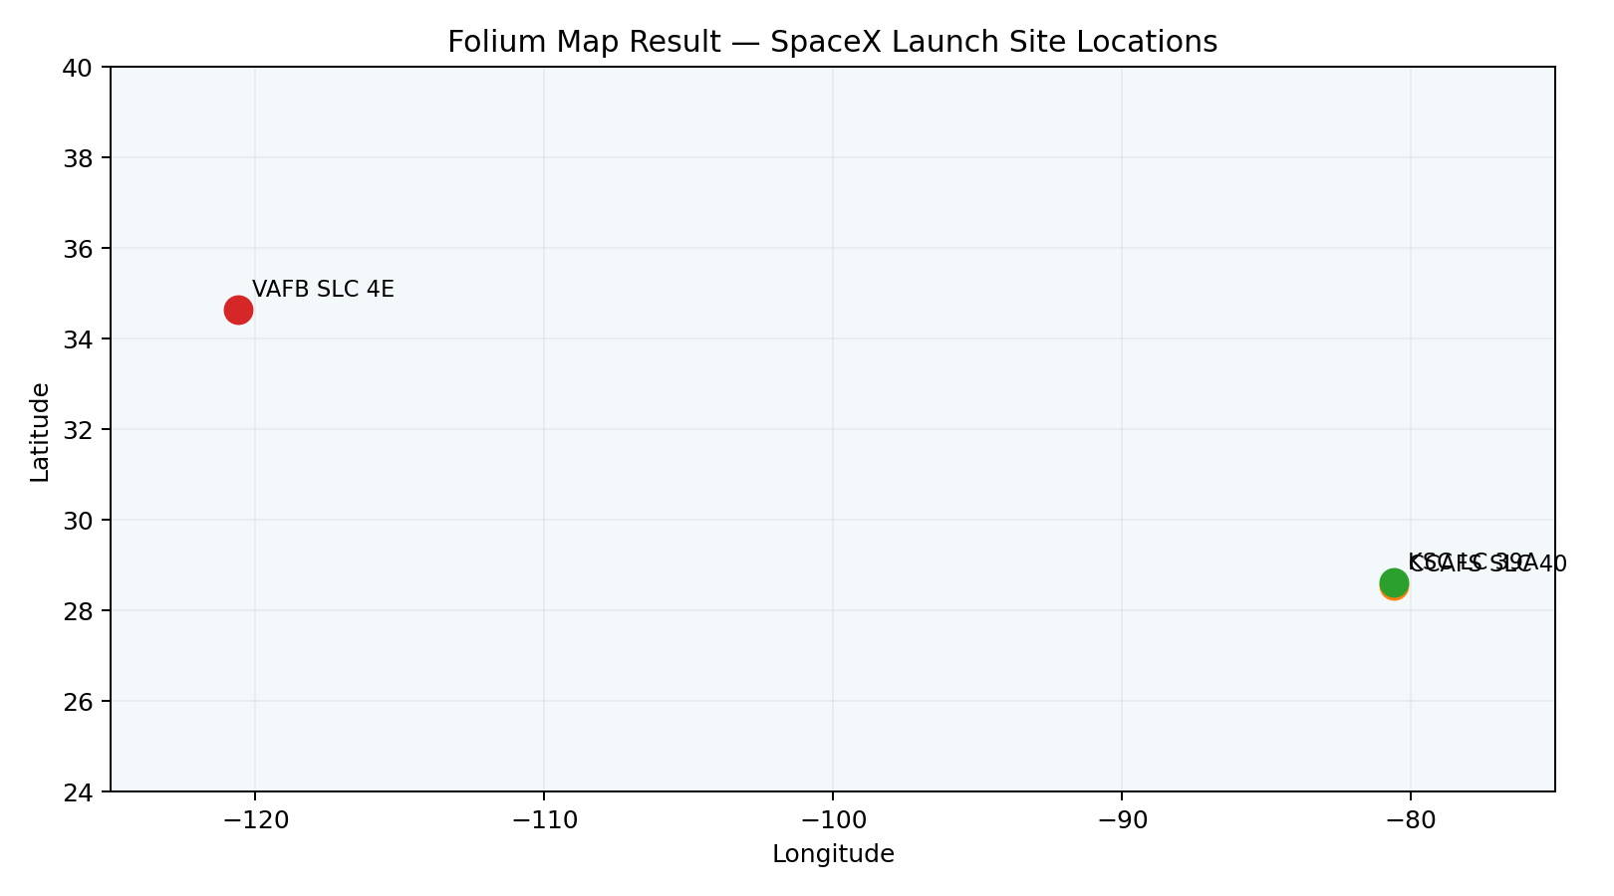
Build an Interactive Map with Folium
• Marker objects identify launch-site coordinates.
• MarkerCluster groups nearby launch outcomes for readability.
• Green / red outcome markers distinguish successful vs. unsuccessful landings.
• Proximity analysis uses circles / lines and distance annotations to connect launch sites with coastlines, highways, railways and nearby cities.
Purpose: translate latitude/longitude into an operational view of launch-site geography and logistics.
SpaceX Falcon 9 Capstone

Slide 14
Build a Dashboard with Plotly Dash
• Dropdown: select a launch site or view all sites.
• Pie chart: success / failure distribution.
• Payload scatter: compare payload mass against landing outcome.
• Range slider: focus on different payload bands.
• Dashboard goal: let stakeholders explore the same evidence without rerunning notebooks.
Interactive design
Inputs
Launch site + payload range
Outputs
Pie + scatter + success ratio
GitHub URL: YOUR_REPOSITORY_URL
SpaceX Falcon 9 Capstone

Slide 15
Predictive Analysis (Classification)
Features
Encode
Scale
Tune
Evaluate
Flight number, payload, orbit, site, booster attributes
→
One-hot categorical variables
→
Standardize where required
→
GridSearchCV / cross-validation
→
Accuracy + confusion matrix
Models compared: Logistic Regression, Support Vector Machine, Decision Tree, K-Nearest Neighbors. The standard capstone test split produced 83.33% accuracy for each model.
GitHub URL: YOUR_REPOSITORY_URL
SpaceX Falcon 9 Capstone

Slide 16
Results
EDA
Interactive analytics
Predictive analysis
Launch, payload, orbit & time patterns
Folium + Plotly Dash
83.33% test accuracy
The results section moves from descriptive evidence to interactive exploration and finally to a predictive model for first-stage landing success.
SpaceX Falcon 9 Capstone

Slide 17

Section 2

Slide 18
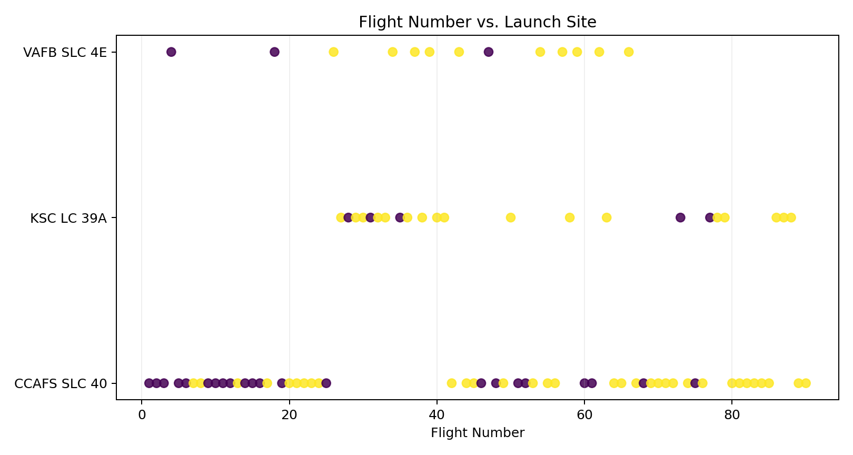
Flight Number vs. Launch Site
Key findings
• Early flights were concentrated at CCAFS SLC 40 and show more failures.
• After roughly flight 30, successful landings become much more frequent.
• KSC LC-39A appears later in the timeline and has a high success share.
SpaceX Falcon 9 Capstone

Slide 19
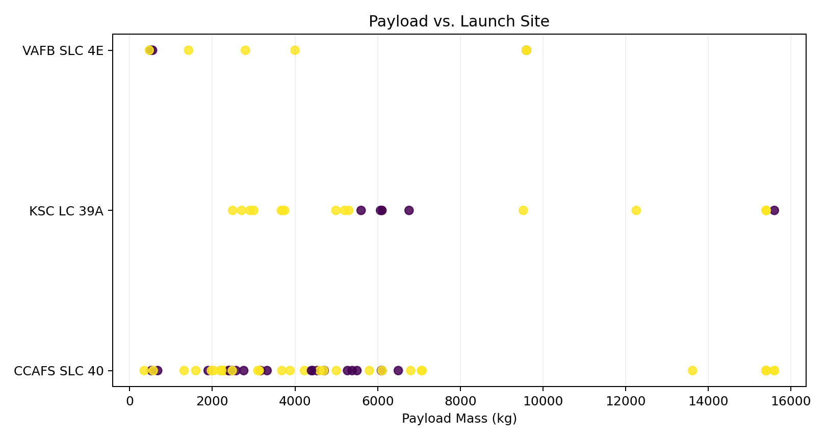
Payload vs. Launch Site
Key findings
• Most launches carry relatively light-to-medium payloads.
• Payloads above ~7,000 kg show few failures in this sample, but the number of observations is smaller.
• Launch site and payload distributions are not identical, supporting site-aware modeling.
SpaceX Falcon 9 Capstone

Slide 20
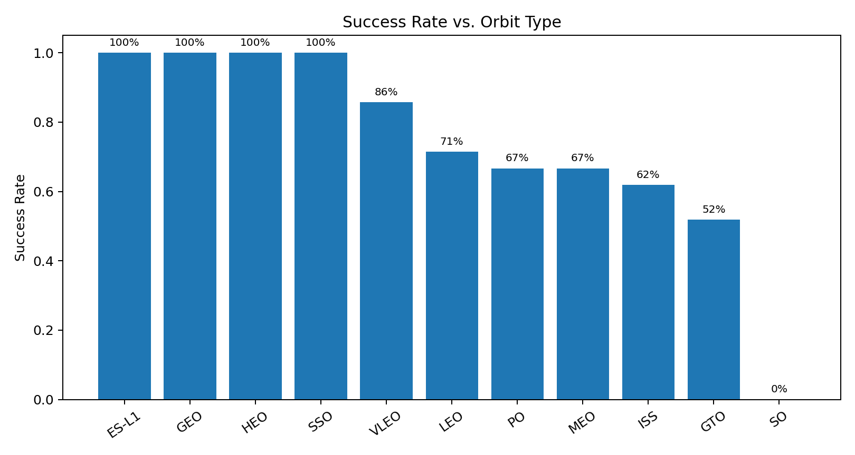
Success Rate vs. Orbit Type
Key findings
• ES-L1, GEO, HEO and SSO show 100% success in this sample.
• SO shows 0% success; GTO is the lowest among the frequently used orbital classes at ~52%.
• Rare-orbit rates should be interpreted cautiously because some have very few observations.
SpaceX Falcon 9 Capstone

Slide 21
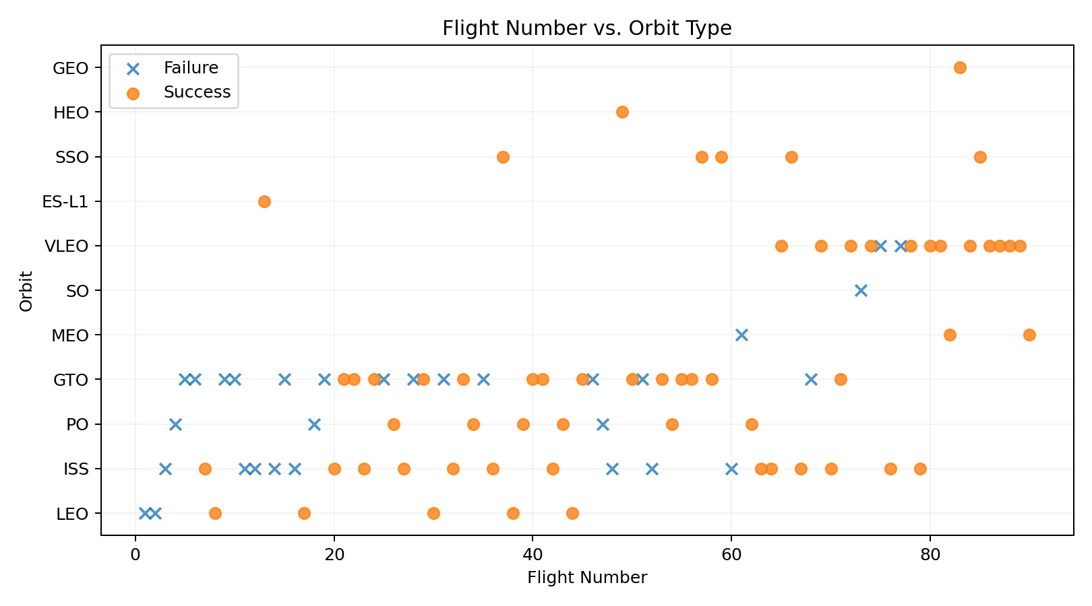
Flight Number vs. Orbit Type
Key findings
• GEO, HEO and ES-L1 have only one successful flight each, explaining their 100% rate.
• LEO shows a clearer time-related improvement in landing outcomes.
• GTO remains mixed across the flight timeline.
SpaceX Falcon 9 Capstone

Slide 22
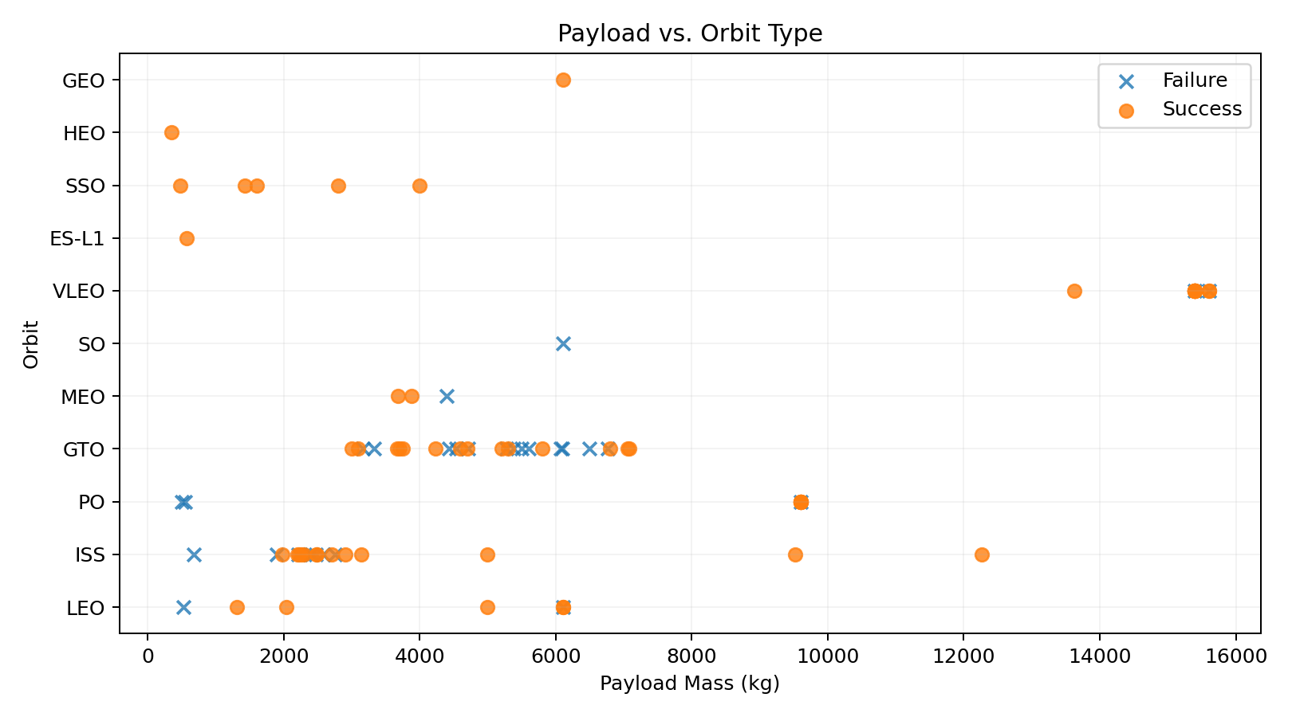
Payload vs. Orbit Type
Key findings
• Most payloads lie below 6,000 kg, with a second concentration at very high VLEO payloads.
• Successful outcomes dominate the higher-payload VLEO region in later years.
• Orbit choice and payload should be considered jointly rather than independently.
SpaceX Falcon 9 Capstone

Slide 23
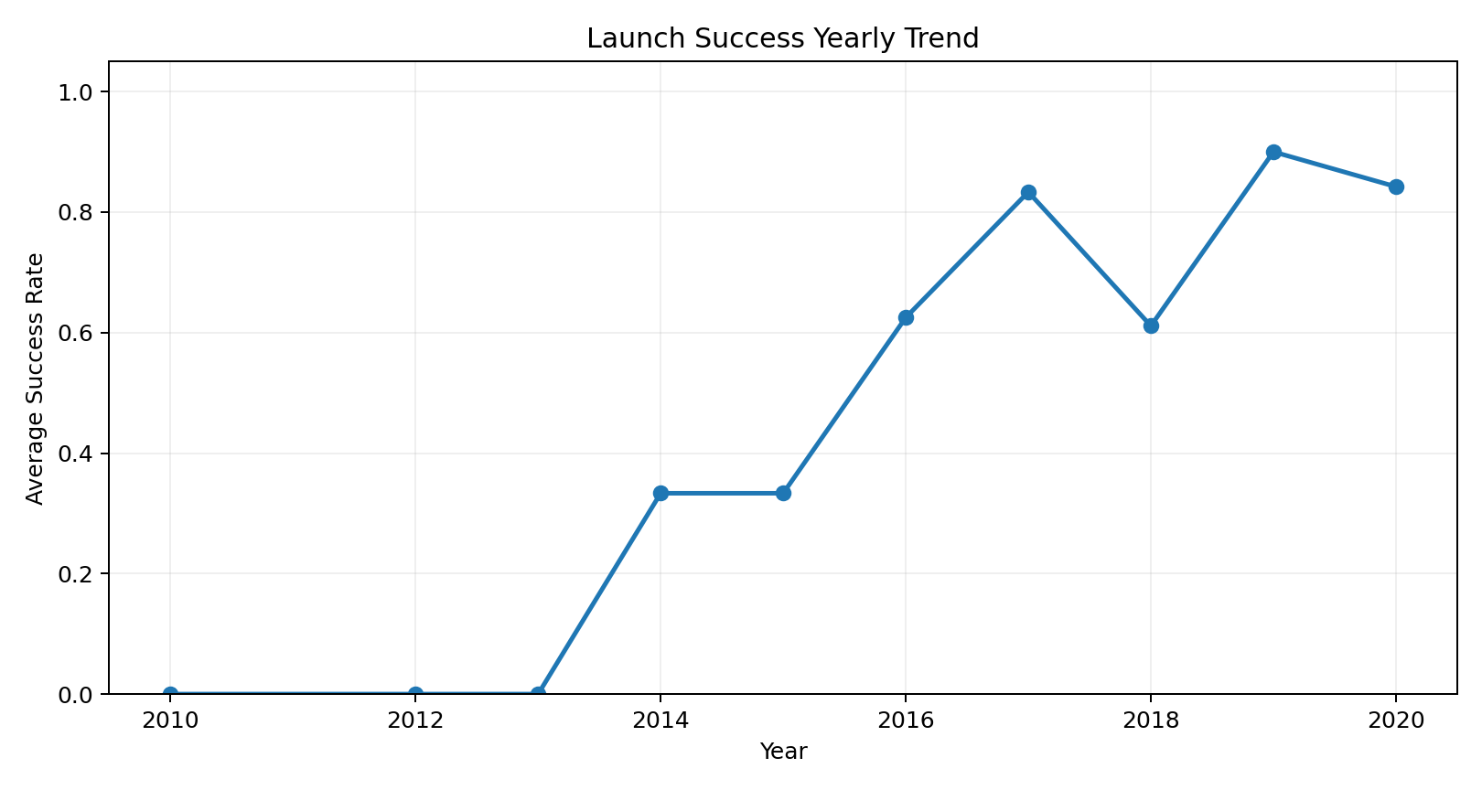
Launch Success Yearly Trend
Key findings
• Landing success improved materially after 2013.
• The trend peaks around 2019 before remaining high in 2020.
• This temporal pattern suggests operational learning and technology maturation.
SpaceX Falcon 9 Capstone

Slide 24
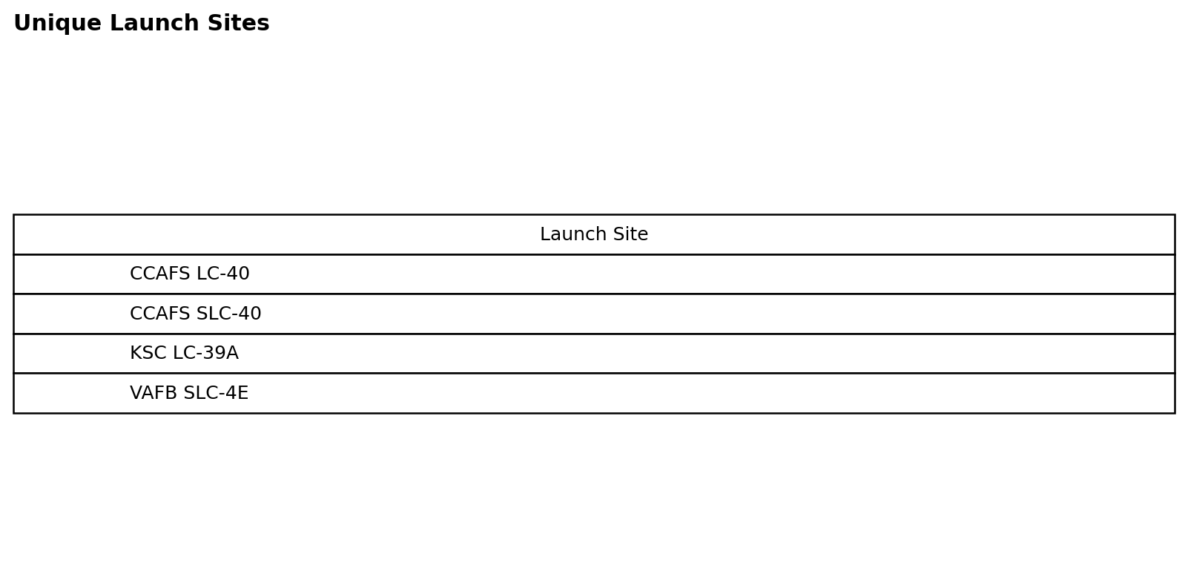
All Launch Site Names
SQL result & interpretation
DISTINCT returns four unique launch-site labels in the SQL dataset. The two CCAFS naming variants are retained because they occur as separate text values.
Notebook: YOUR_REPOSITORY_URL
SpaceX Falcon 9 Capstone

Slide 25
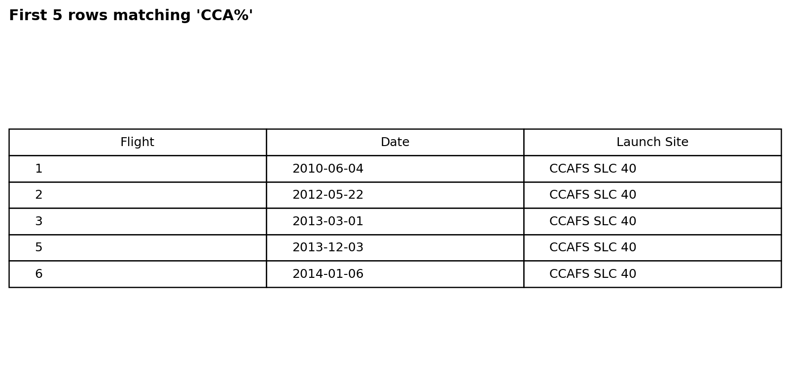
Launch Site Names Begin with 'CCA'
SQL result & interpretation
LIKE 'CCA%' isolates records whose launch-site text begins with CCA; LIMIT 5 returns the first five matching records.
Notebook: YOUR_REPOSITORY_URL
SpaceX Falcon 9 Capstone

Slide 26
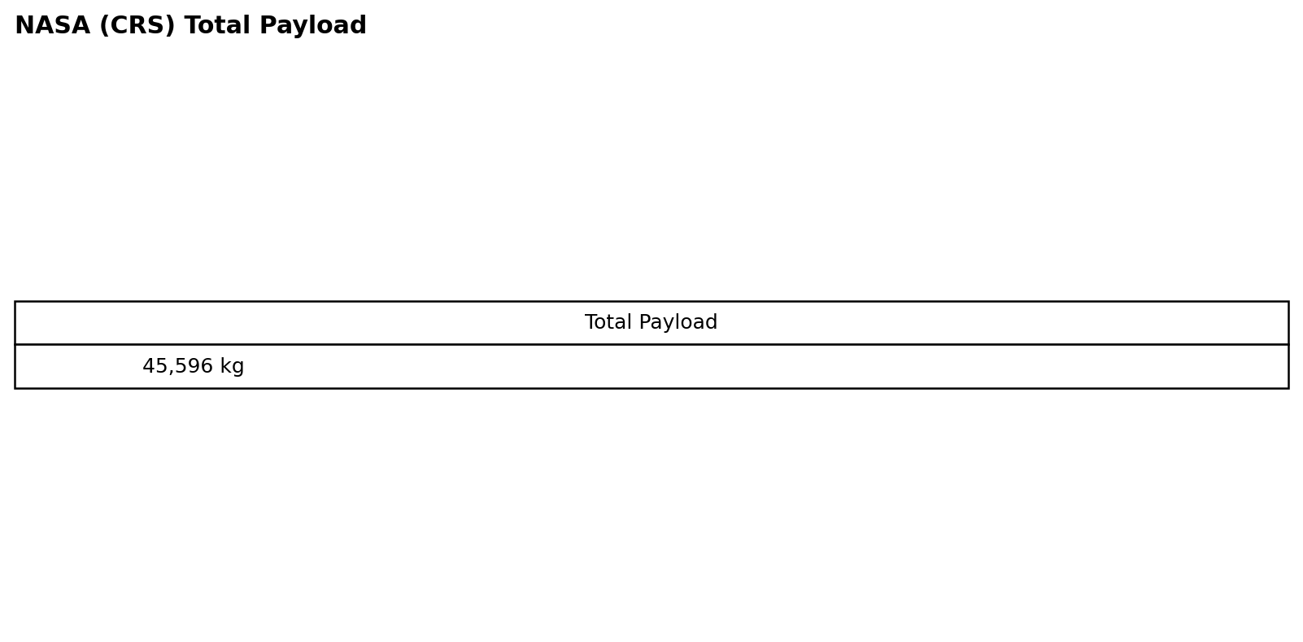
Total Payload Mass
SQL result & interpretation
NASA (CRS) missions carried 45,596 kg of payload in the analyzed SQL dataset.
Notebook: YOUR_REPOSITORY_URL
SpaceX Falcon 9 Capstone

Slide 27
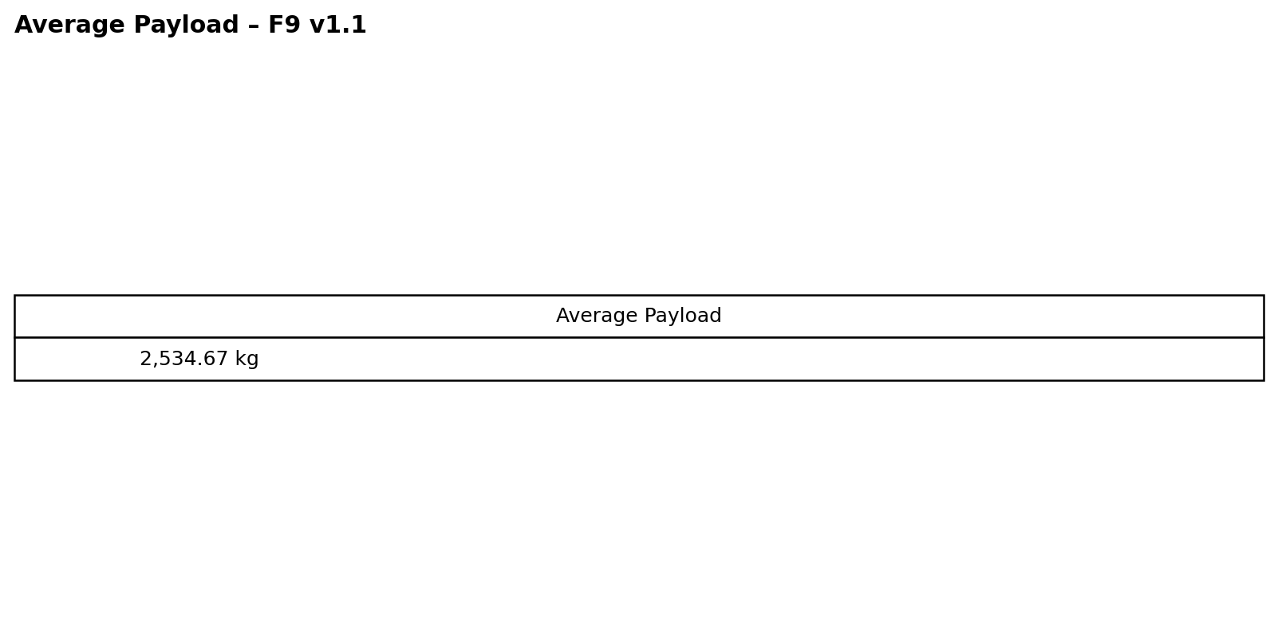
Average Payload Mass by F9 v1.1
SQL result & interpretation
AVG(payload_mass__kg_) gives an average of approximately 2,534.67 kg for F9 v1.1 boosters.
Notebook: YOUR_REPOSITORY_URL
SpaceX Falcon 9 Capstone

Slide 28
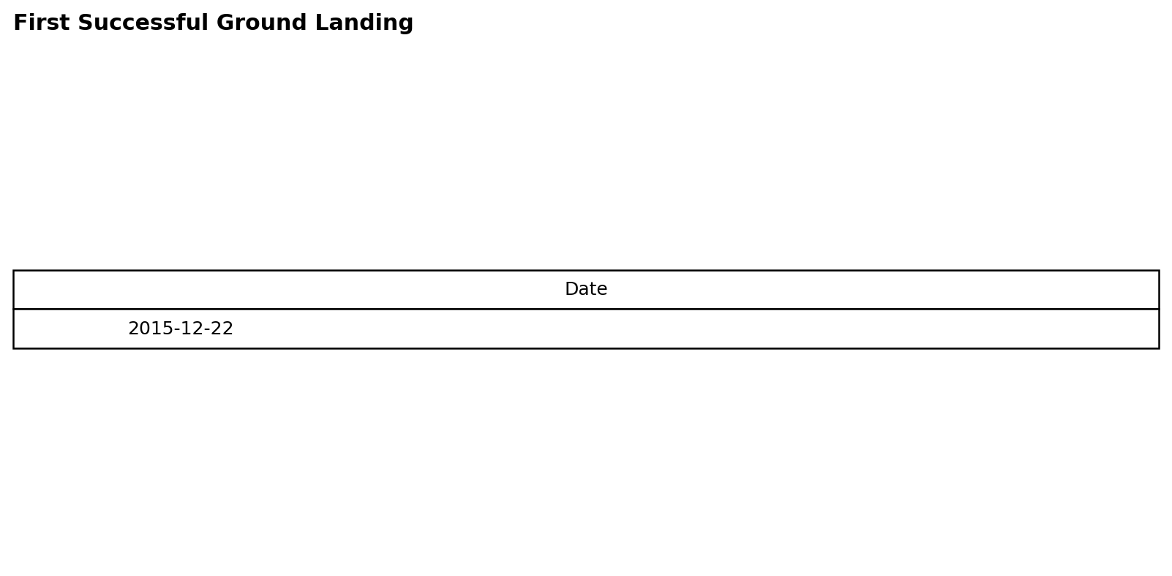
First Successful Ground Landing Date
SQL result & interpretation
MIN(Date) identifies 2015-12-22 as the first successful ground-pad landing.
Notebook: YOUR_REPOSITORY_URL
SpaceX Falcon 9 Capstone

Slide 29
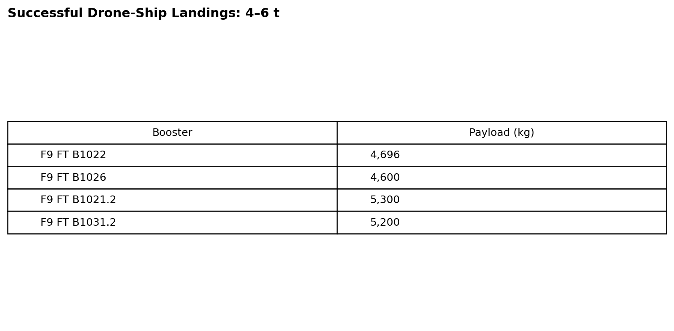
Successful Drone Ship Landing with Payload between 4000 and 6000
SQL result & interpretation
Four booster versions meet the successful drone-ship and payload-range criteria.
Notebook: YOUR_REPOSITORY_URL
SpaceX Falcon 9 Capstone

Slide 30
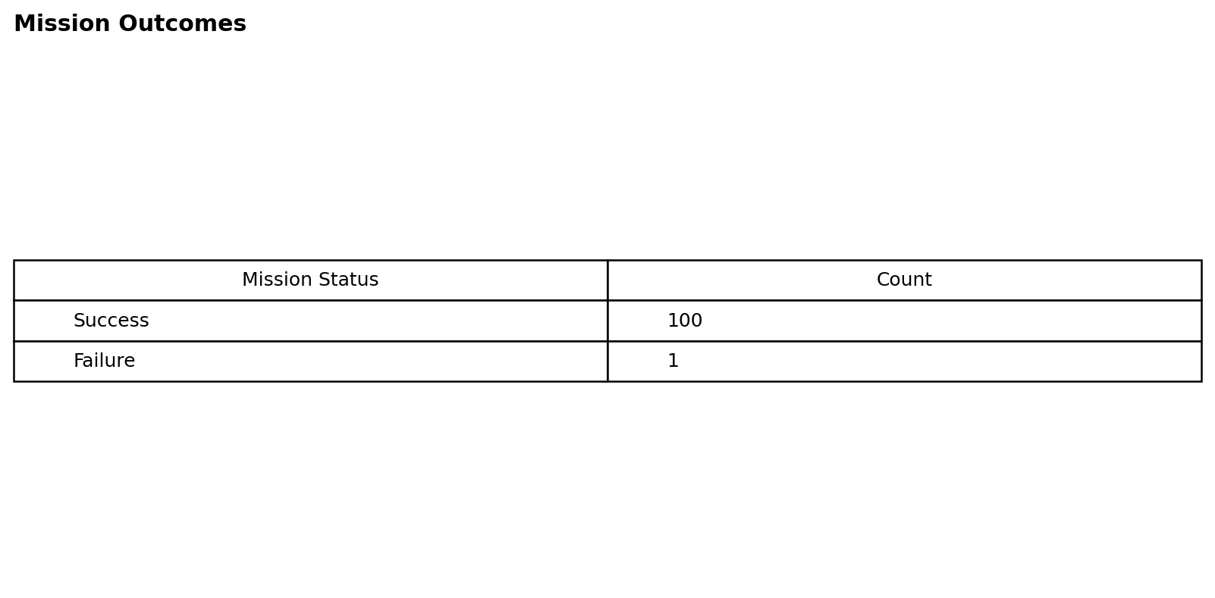
Total Number of Successful and Failure Mission Outcomes
SQL result & interpretation
The mission-outcome query reports 100 successful outcomes and 1 failure in the SQL dataset.
Notebook: YOUR_REPOSITORY_URL
SpaceX Falcon 9 Capstone

Slide 31
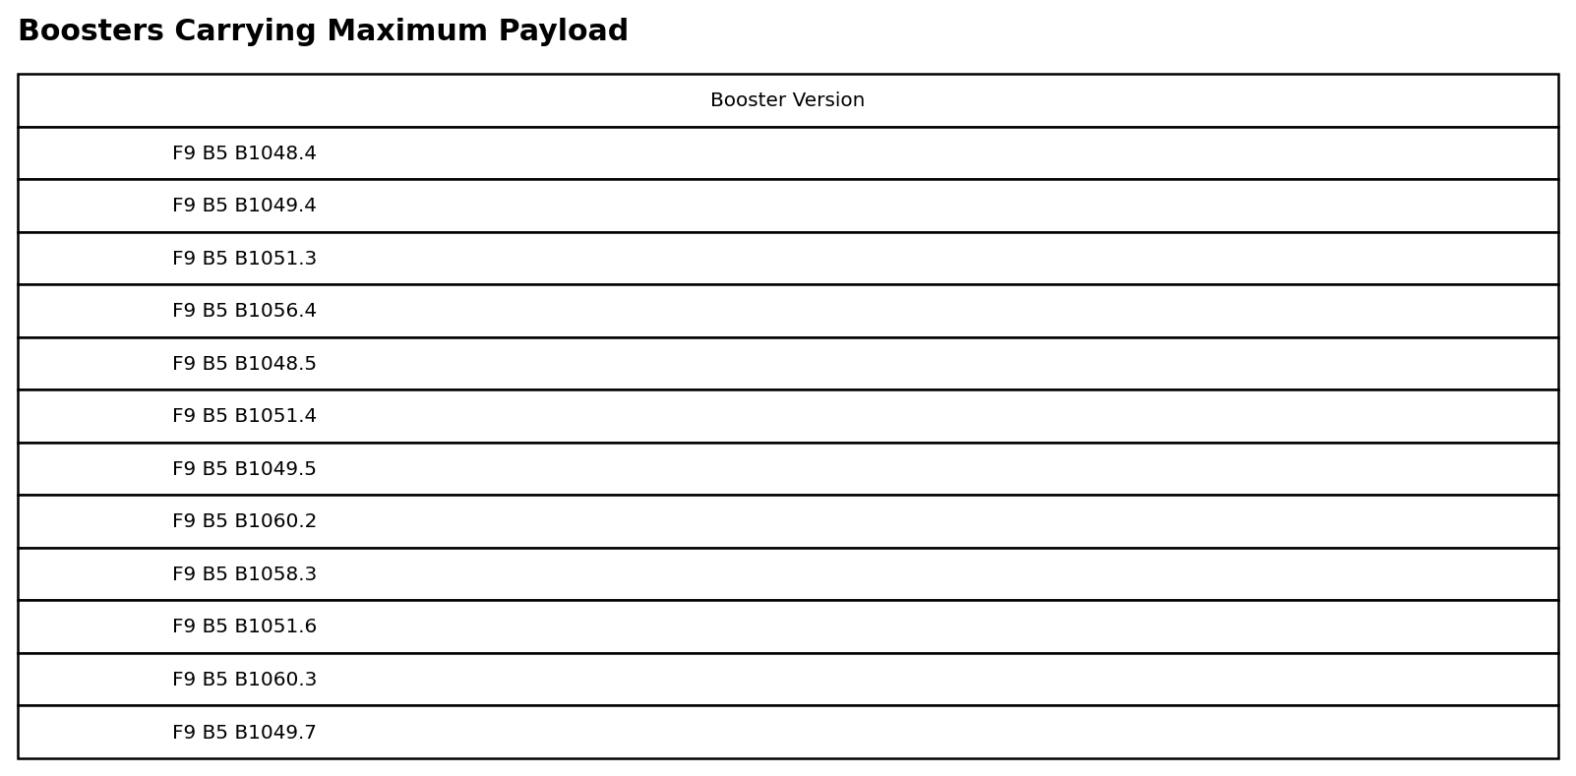
Boosters Carried Maximum Payload
SQL result & interpretation
A MAX subquery identifies 12 booster versions associated with the maximum payload mass.
Notebook: YOUR_REPOSITORY_URL
SpaceX Falcon 9 Capstone

Slide 32
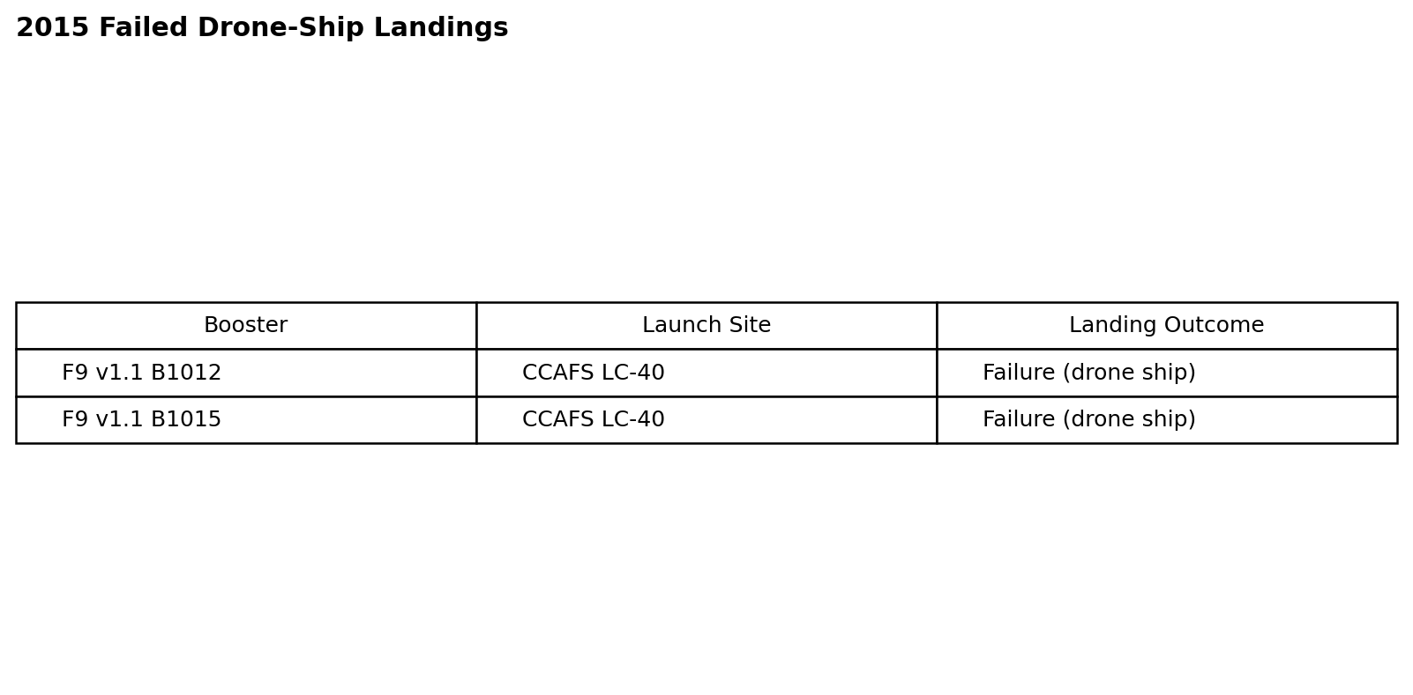
2015 Launch Records
SQL result & interpretation
Two failed drone-ship landing attempts in 2015 occurred from CCAFS LC-40: B1012 and B1015.
Notebook: YOUR_REPOSITORY_URL
SpaceX Falcon 9 Capstone

Slide 33
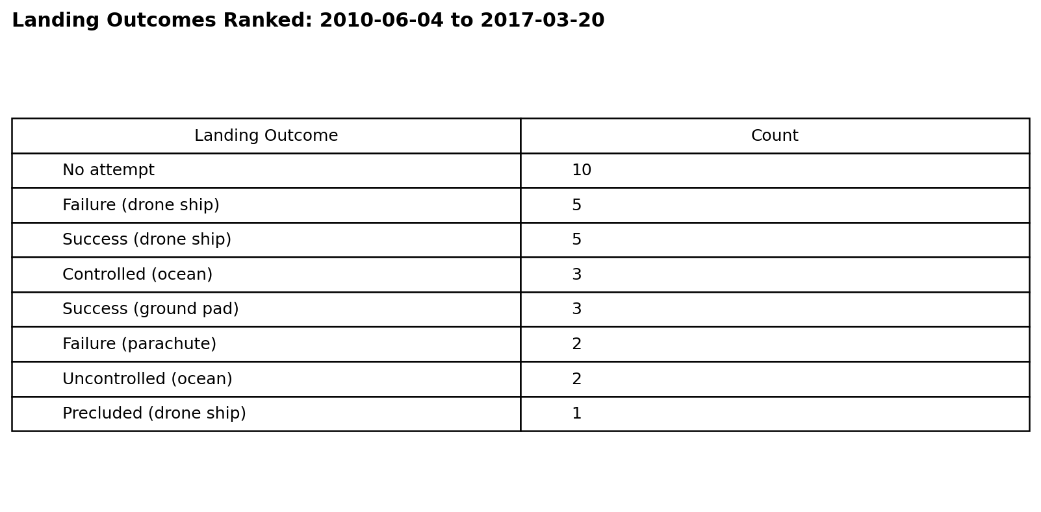
Rank Landing Outcomes Between 2010-06-04 and 2017-03-20
SQL result & interpretation
No attempt is the most frequent outcome in this early period; drone-ship success and failure each occur five times.
Notebook: YOUR_REPOSITORY_URL
SpaceX Falcon 9 Capstone

Slide 34

Section 3

Slide 35
Folium Map — Launch Site Locations
Key findings
• Three orbital launch-site locations appear in Florida and California.
• All launch sites are coastal, consistent with over-ocean launch and stage-drop safety requirements.
• The map provides geographic context for the later outcome analysis.
SpaceX Falcon 9 Capstone

Slide 36
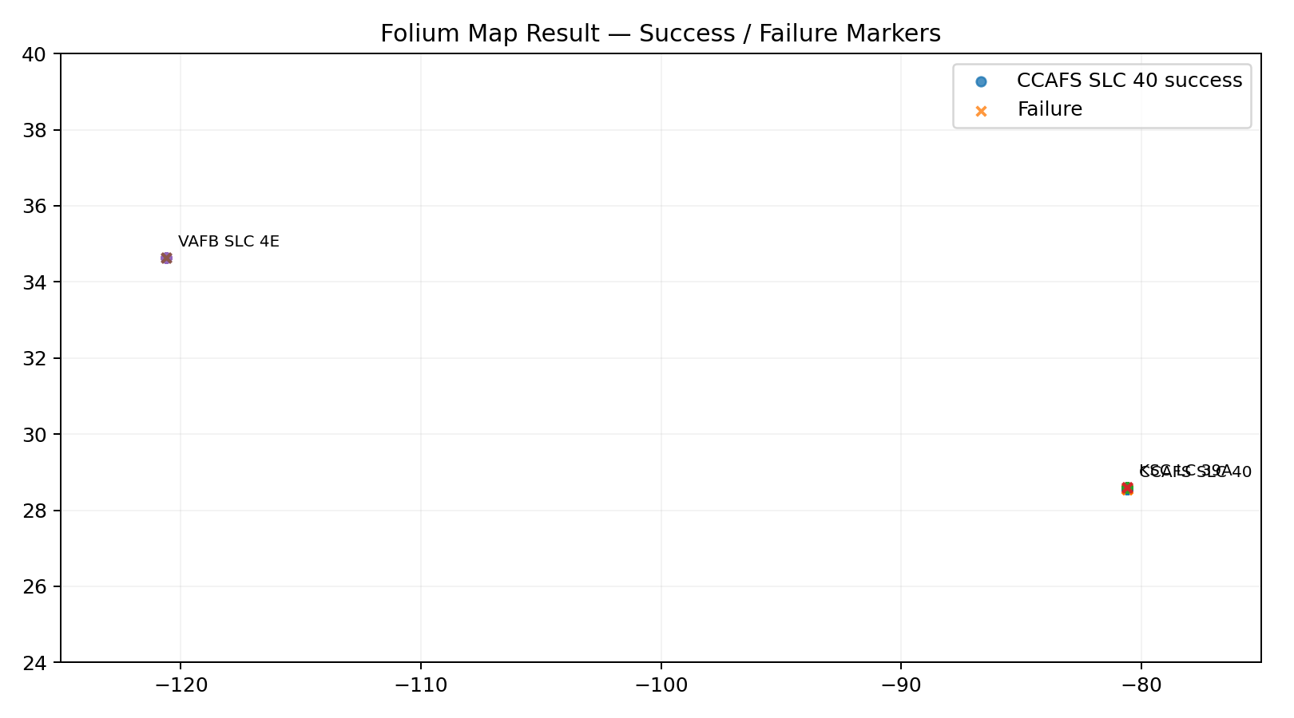
Folium Map — Success / Failure Outcomes
Key findings
• Marker clustering reduces overlap when many launches share a site.
• Successful and failed outcomes are visually separated to expose site-level patterns.
• CCAFS SLC-40 has the largest launch volume; KSC LC-39A and VAFB SLC-4E show strong success shares.
SpaceX Falcon 9 Capstone

Slide 37
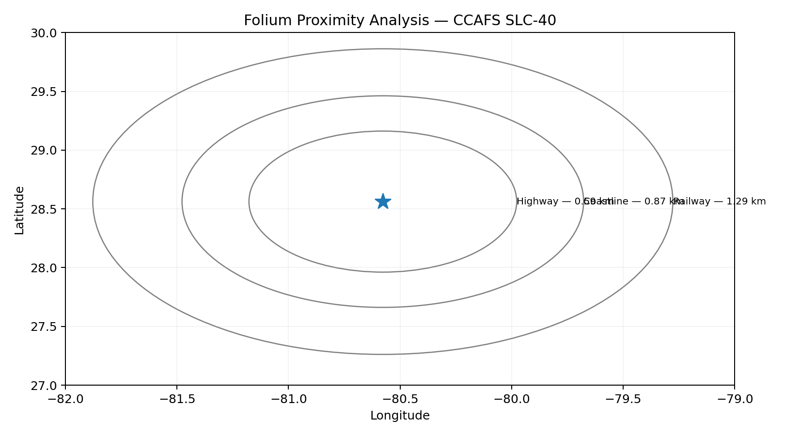
Folium Proximity Analysis — CCAFS SLC-40
Key findings
• Reported proximity results: coastline ≈ 0.87 km; highway ≈ 0.59 km; railway ≈ 1.29 km; nearest city ≈ 51.74 km.
• The combination of coastal access and nearby transport infrastructure supports launch logistics.
• Distance annotations turn a location map into an operational planning view.
SpaceX Falcon 9 Capstone

Slide 38

Section 4

Slide 39
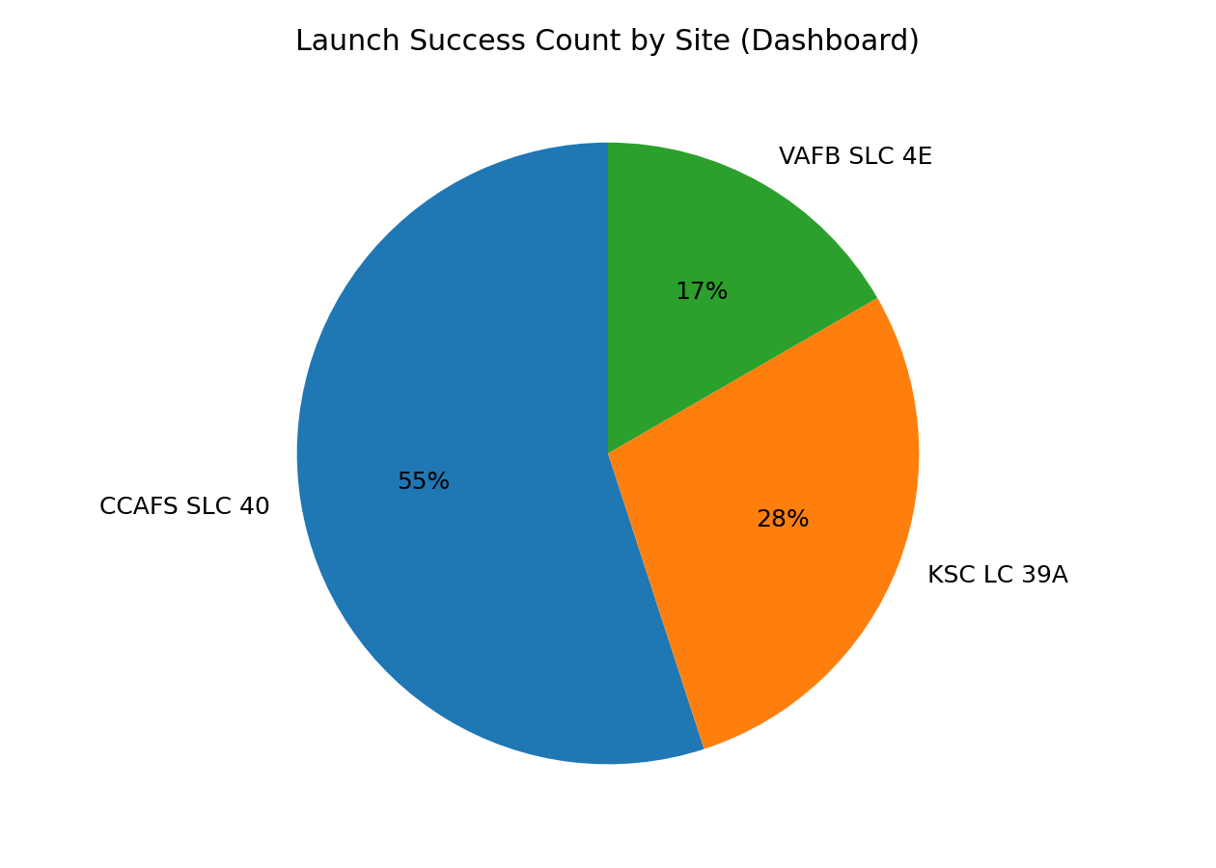
Plotly Dash — Launch Success Distribution
Dashboard insight
• The dashboard compares success counts across launch sites.
• CCAFS SLC-40 has the largest number of successful landings in the 90-record EDA dataset.
• The site selector allows the same view to be narrowed to one launch complex.
SpaceX Falcon 9 Capstone

Slide 40
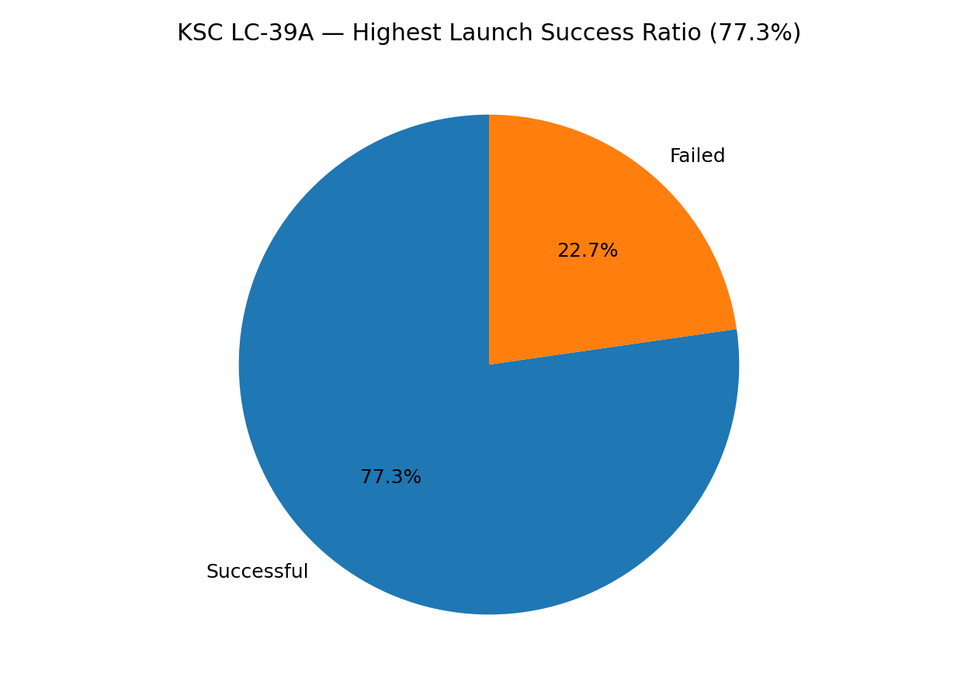
Plotly Dash — Highest Launch Success Ratio
Dashboard insight
• KSC LC-39A has the highest site-level success ratio in the 90-record EDA dataset: 17/22 ≈ 77.3%.
• This differs from launch-volume leadership: CCAFS SLC-40 has more total launches.
• The distinction between volume and reliability is operationally important.
SpaceX Falcon 9 Capstone

Slide 41
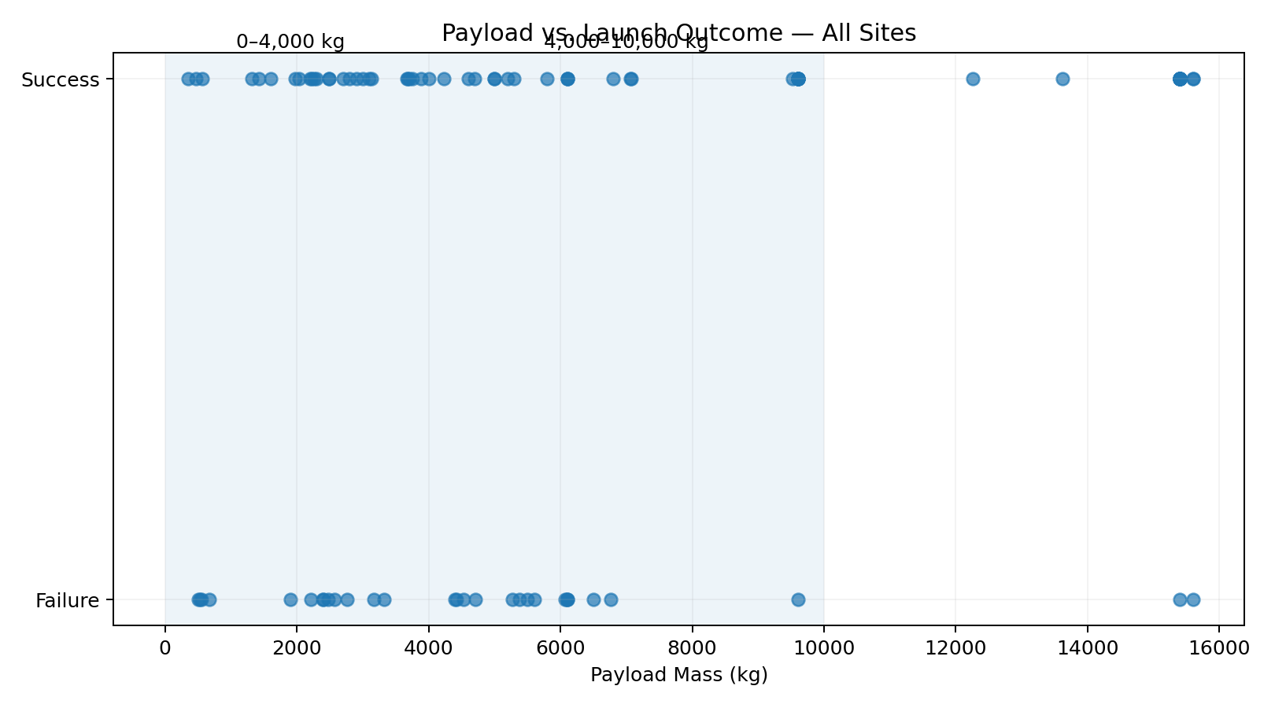
Plotly Dash — Payload vs. Launch Outcome
Dashboard insight
• A payload range control helps separate low- and high-payload mission profiles.
• The 0–4,000 kg region contains many successful launches; heavier missions are fewer and more heterogeneous.
• Booster generation and orbit interact with payload, so payload alone is not a sufficient predictor.
SpaceX Falcon 9 Capstone

Slide 42

Section 5

Slide 43
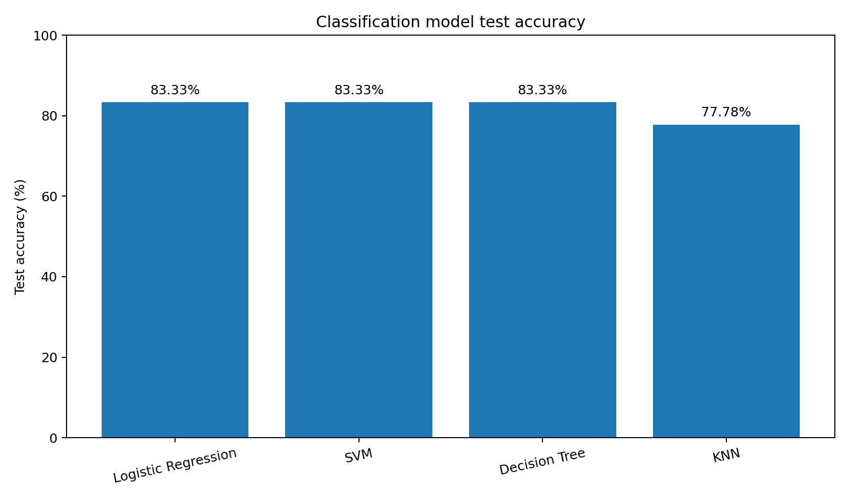
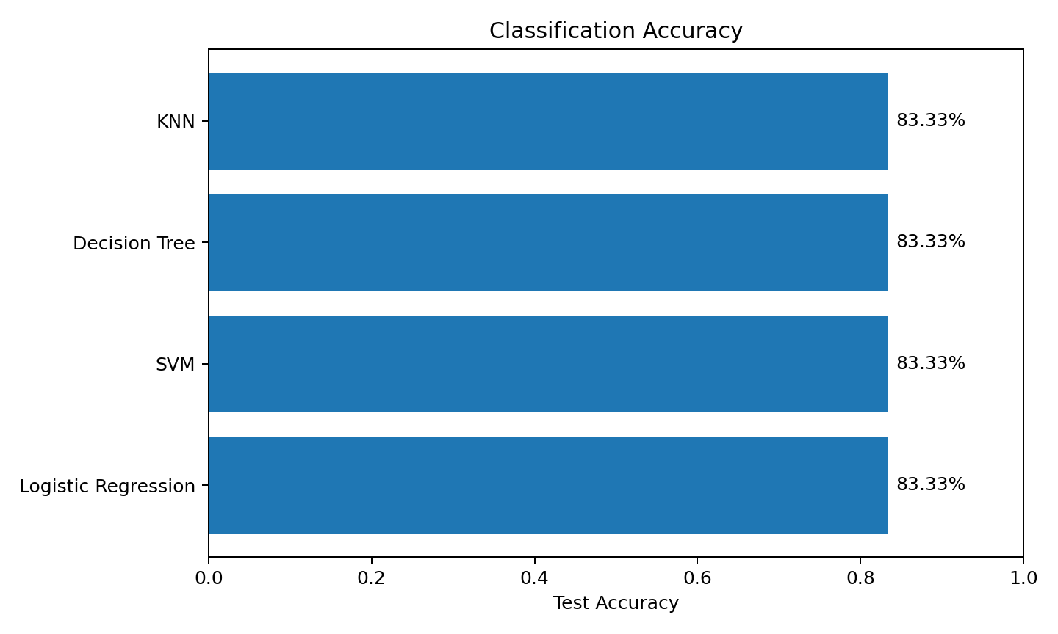
Classification Accuracy
Result
Reproduced on the 90-row capstone extract with the standard 80/20 split (random_state=2).
• Logistic Regression: 83.33%
• SVM: 83.33%
• Decision Tree: 83.33%
• KNN: 77.78%
Decision Tree had the strongest 10-fold GridSearchCV score (~89.1%).
SpaceX Falcon 9 Capstone

Slide 44
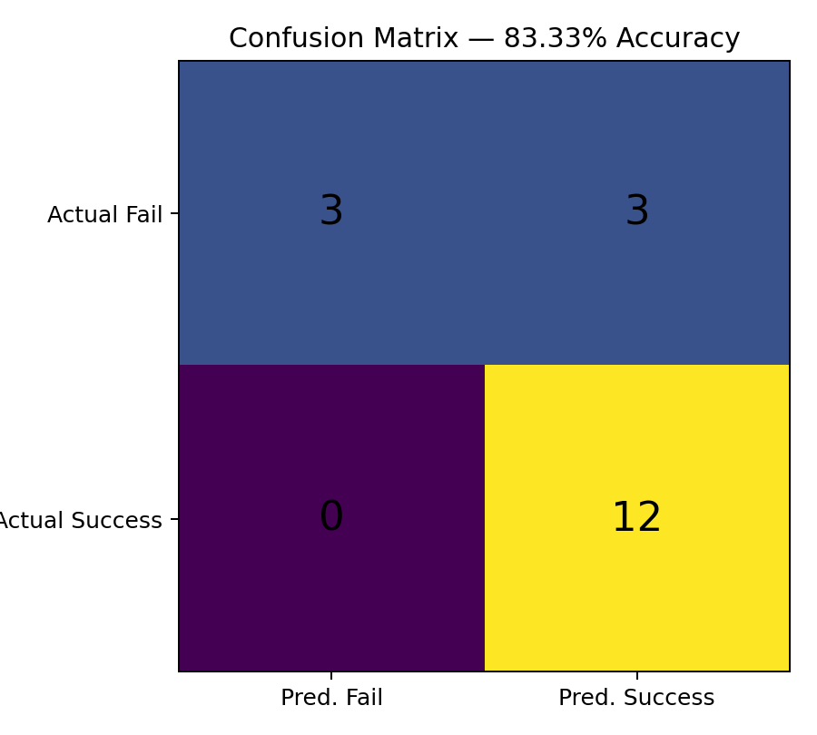
Confusion Matrix
• TN = 3: unsuccessful landings correctly identified.
• FP = 3: failures predicted as successful landings.
• FN = 0: no successful landings were missed.
• TP = 12: successful landings correctly identified.
• Accuracy = (3 + 12) / 18 = 83.33%.
Model-selection insight: accuracy alone hides the cost of false positives; operational deployment should also consider precision, recall and the business cost of an incorrect landing prediction.
SpaceX Falcon 9 Capstone

Slide 45
Conclusions
• Landing success improved substantially over time, especially after the early Falcon 9 flights.
• KSC LC-39A has the highest site-level landing success ratio in the analyzed 90-record dataset, while CCAFS SLC 40 has the highest launch volume.
• ES-L1, GEO, HEO and SSO show 100% success in this sample, while SO shows 0%; rare-orbit rates require cautious interpretation.
• Payload, orbit, launch site and flight history jointly provide useful predictive information.
• Four classification approaches achieved 83.33% test accuracy on the standard split; the small test set limits confidence in fine-grained model ranking.
• Interactive maps and dashboards make the analysis easier to explore and communicate than static tables alone.
SpaceX Falcon 9 Capstone

Slide 46
Appendix
• Feature engineering: one-hot encoding of categorical variables.
• Landing label: Class = 1 successful first-stage landing; Class = 0 unsuccessful.
• SQL patterns: DISTINCT, LIKE, LIMIT, SUM, AVG, MIN, GROUP BY, COUNT, subqueries.
• Modeling: train/test split, scaling where required, GridSearchCV, confusion matrix.
Repository & external references
GitHub repository:
YOUR_REPOSITORY_URL
Primary analysis source:
IBM Applied Data Science Capstone — SpaceX Falcon 9 landing dataset and course workflow.
Before submission, replace YOUR_REPOSITORY_URL with your own completed GitHub repository.
SpaceX Falcon 9 Capstone

Slide 47

Project References & Submission Checklist
• ✓ Executive summary, introduction and methodology included.
• ✓ Data collection, web scraping and wrangling documented.
• ✓ EDA visualization and SQL results included.
• ✓ Folium map and Plotly Dash results included.
• ✓ Classification accuracy and confusion matrix included.
• ✓ Conclusion and innovative insights included.
• ⚠ Replace YOUR_REPOSITORY_URL with the GitHub repository containing your completed notebooks / Python files before submission.
Final submission filename: Data Science Capstone Project Report.pdf
SpaceX Falcon 9 Capstone

